Slide 1
Important Results from the Summer
Adam Shah

Slide 2
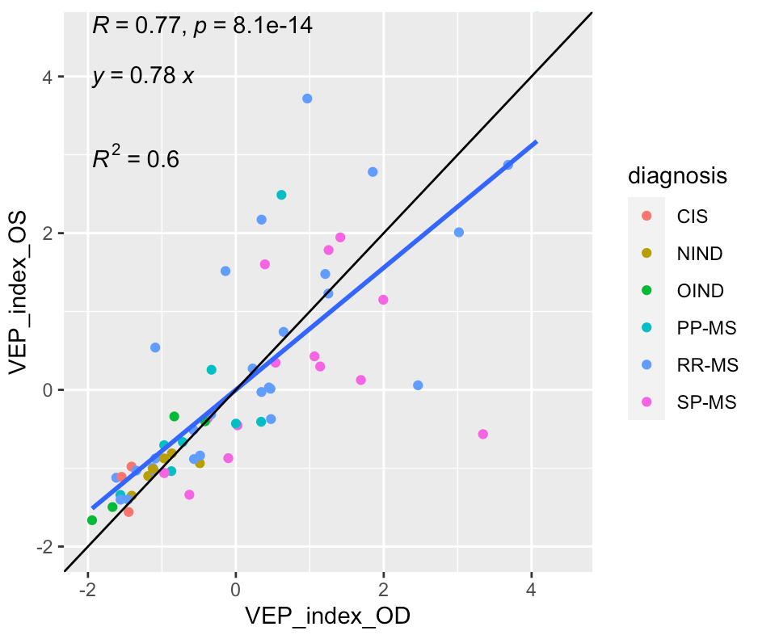
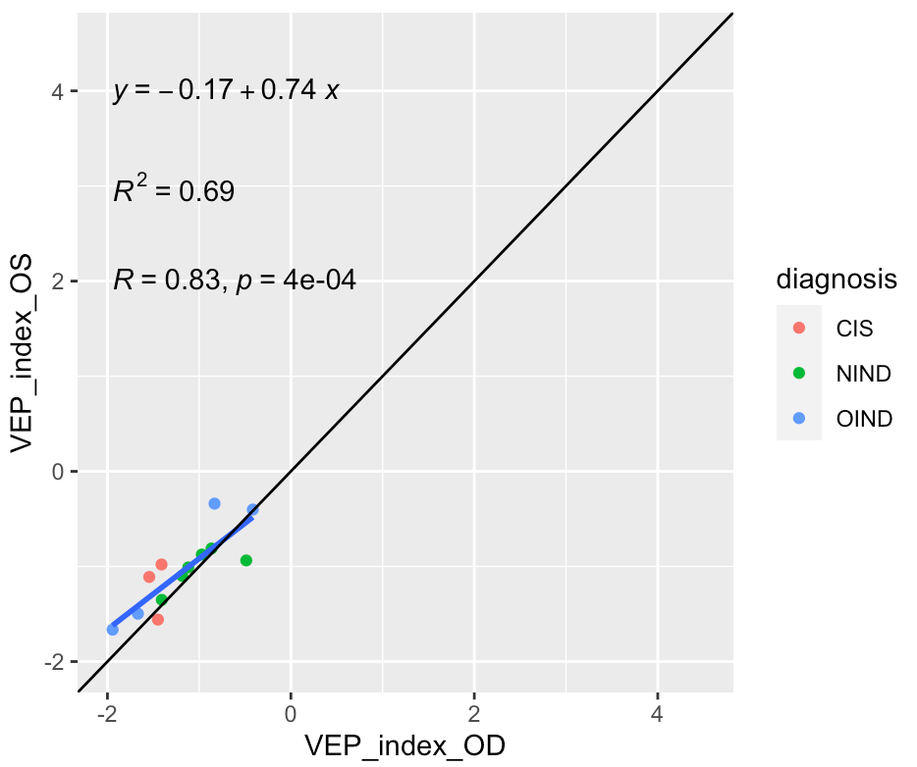
VEP index analysis
Comparison between eyes of VEP index (calculated through PCA) in all diagnoses vs. non-MS patients
Full data set (n=64)
Non-MS cohort (n=13)

Slide 3
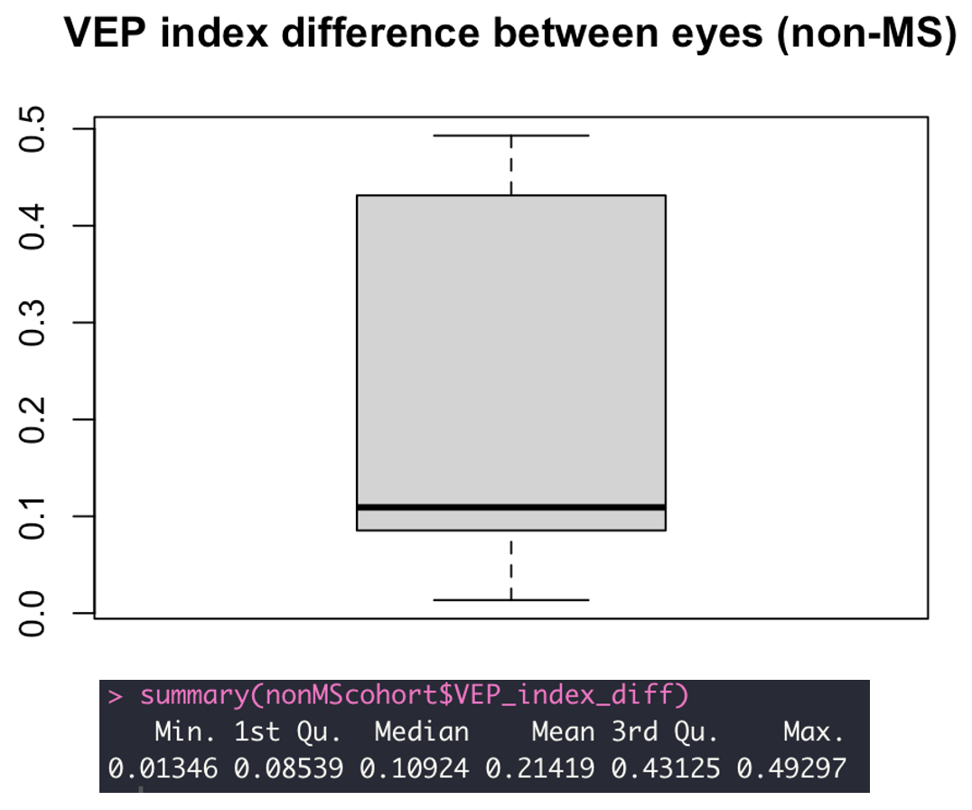
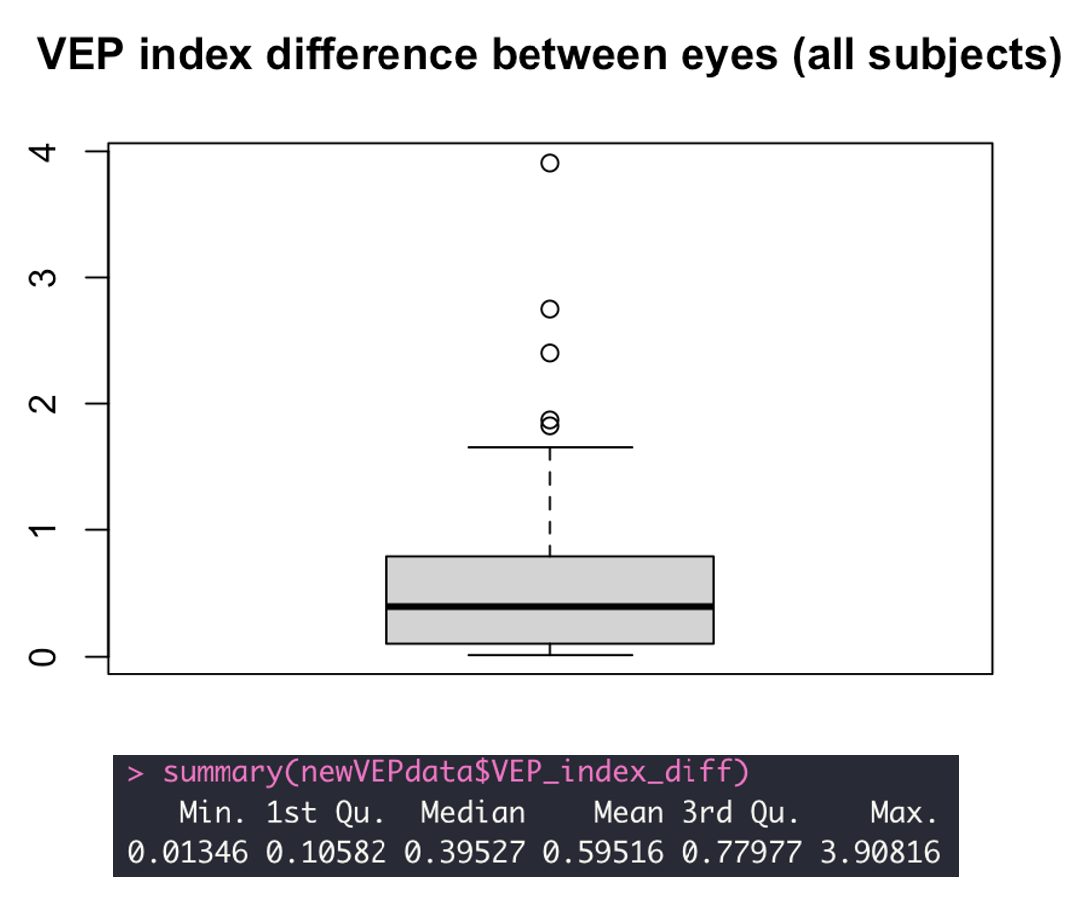
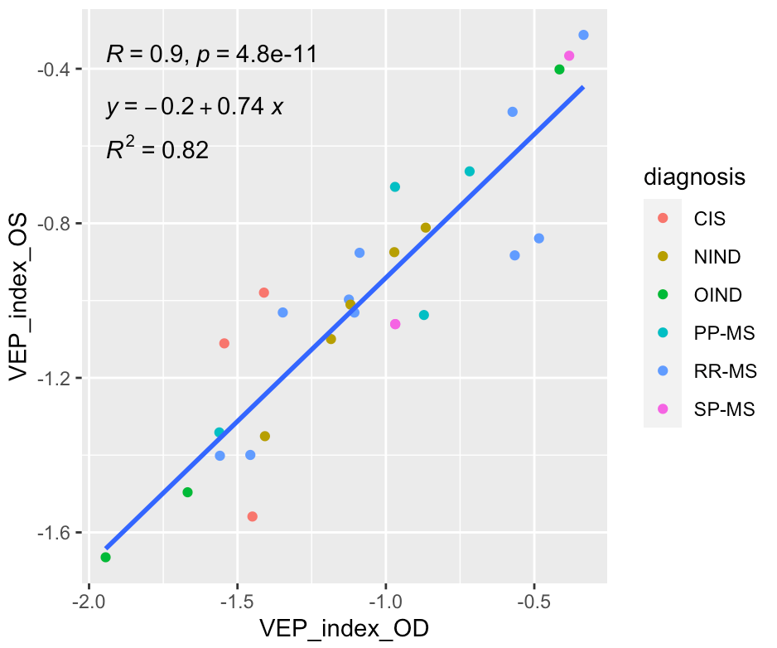
Isolating “normal eyes” based on VEP
Isolated “normal-eyed” people
in the data set (n= 28)

Slide 4
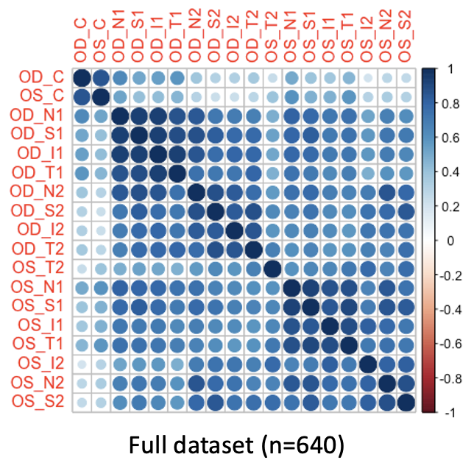
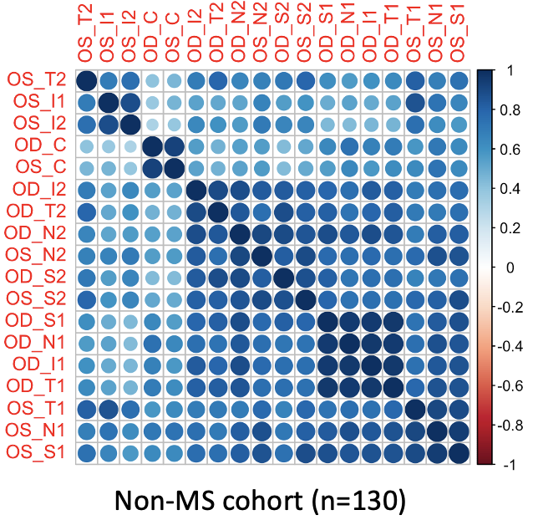
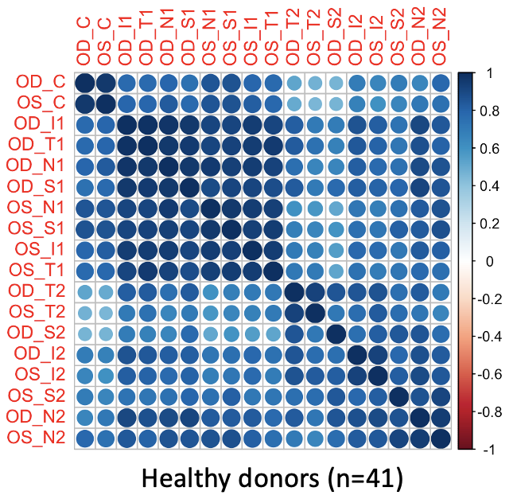
Correlations in ILM-RPE OCT regions
Blanks: p-value > 0.01

Slide 5
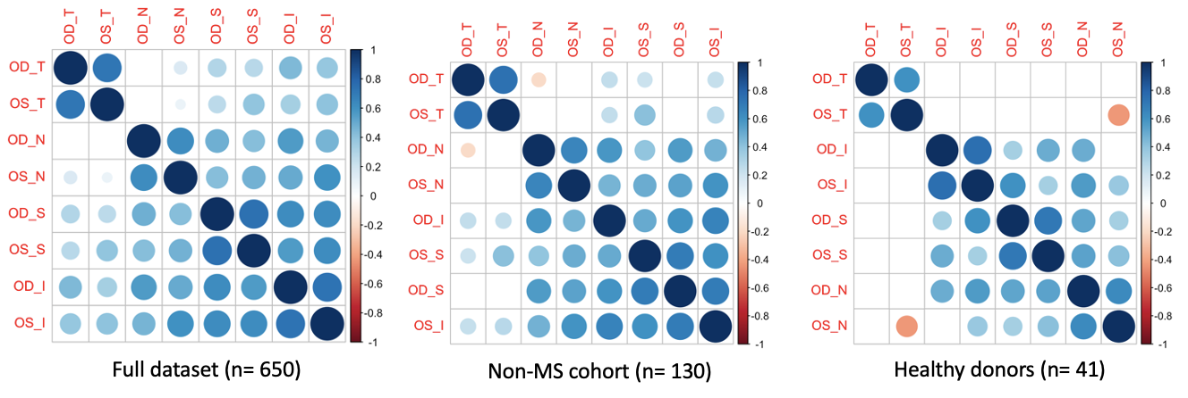
Correlations in RNFL regions
Blanks: p-value > 0.05 for rest of slides

Slide 6
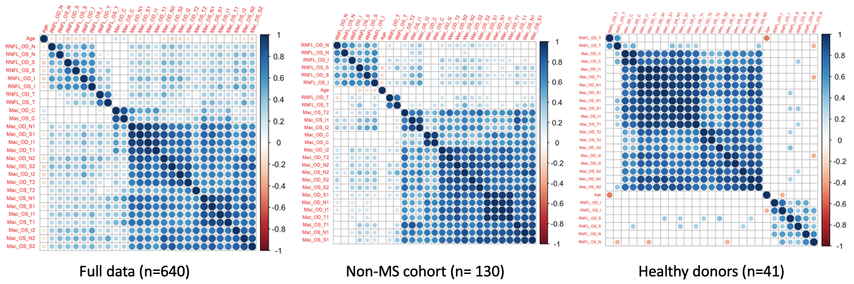
Correlations in all OCT measures and age

Slide 7
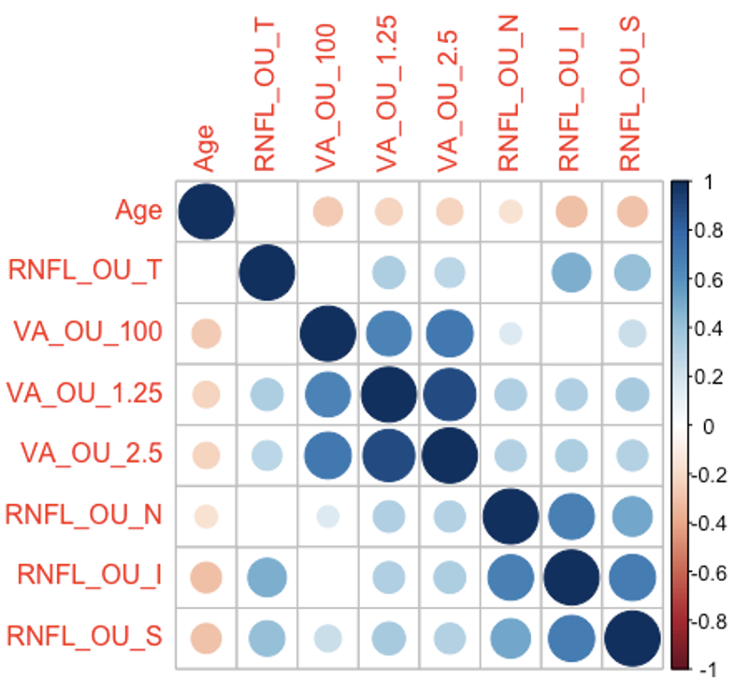
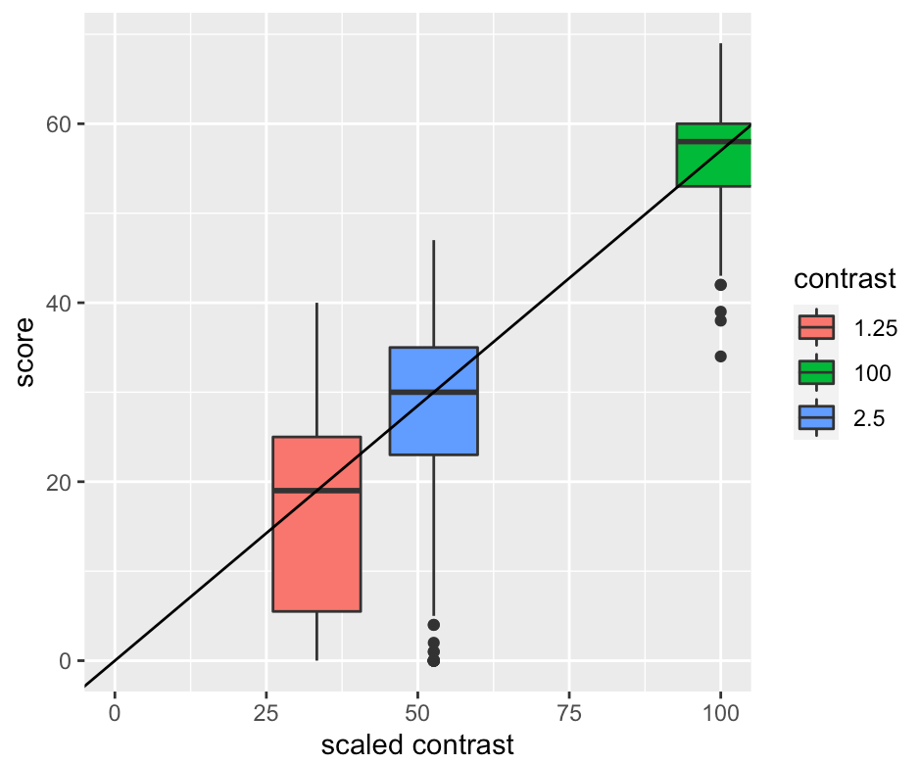
RNFL-VA correlations and scale for VA regression based on “normal” RNFL eyes (3 contrast)

Slide 8
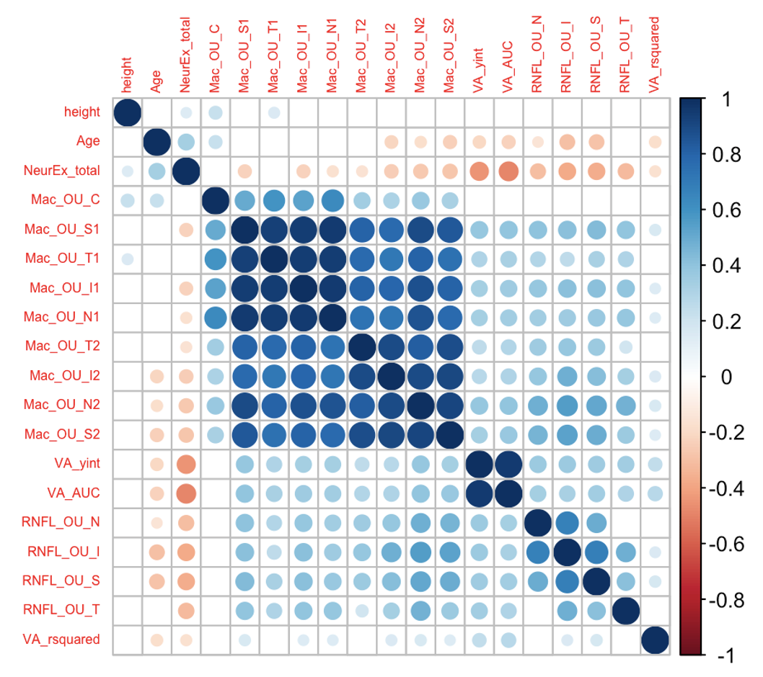
Initial VA regression measures correlations

Slide 9
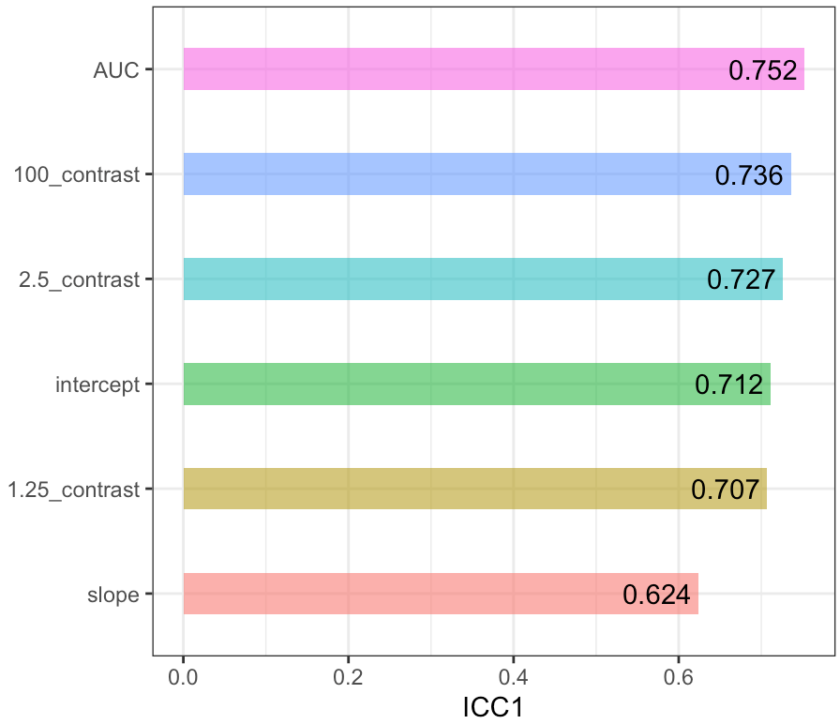
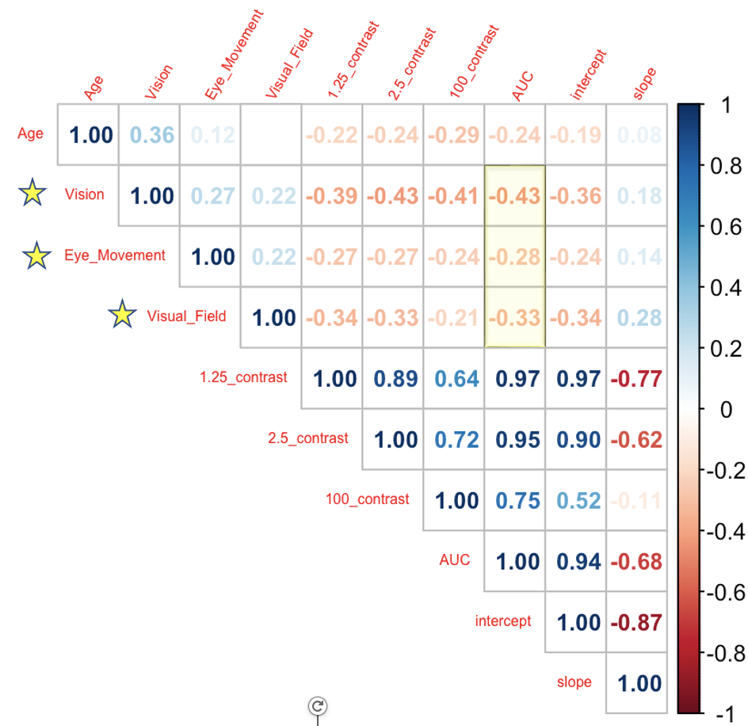
Validation of VA AUC (ICC and correlations with NeurEx and other VA measures)

Slide 10
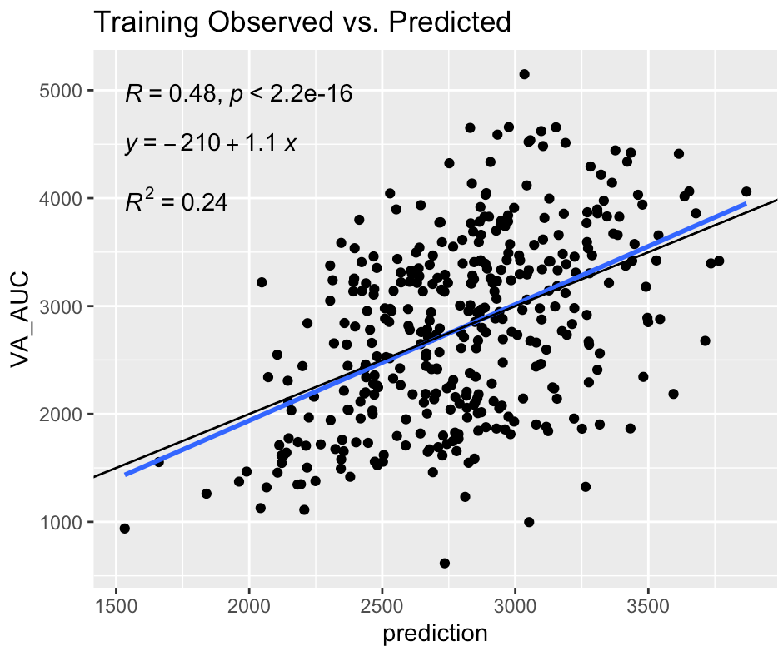
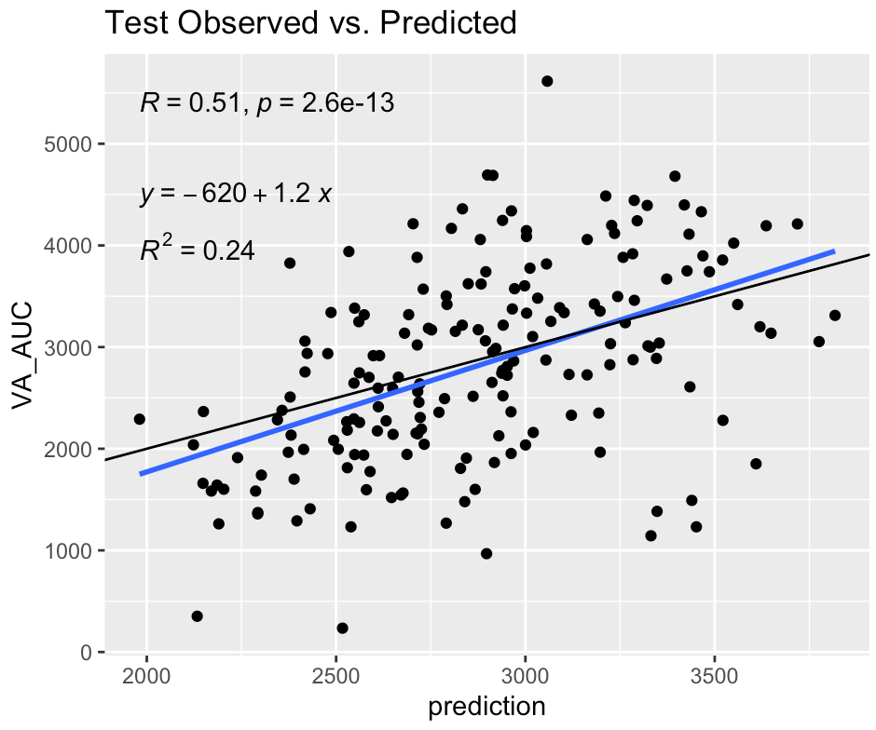
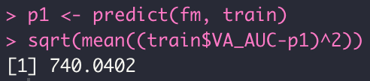
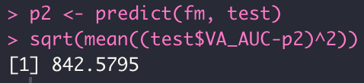
Elastic net AUC model w/ OCT (binocular)
For all models, see individual PowerPoints for more detailed data partition and parameter and coefficient values
RMSE for training data
RMSE for testing data

Slide 11
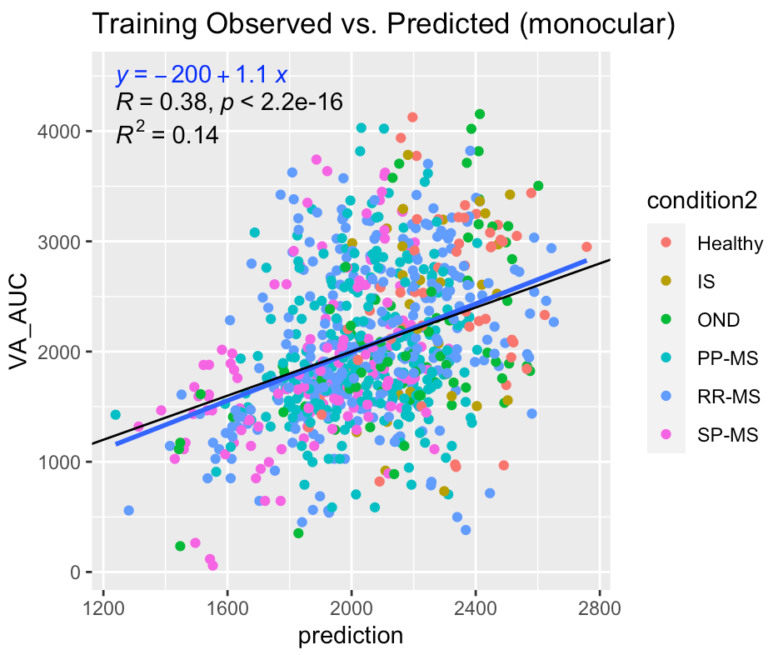
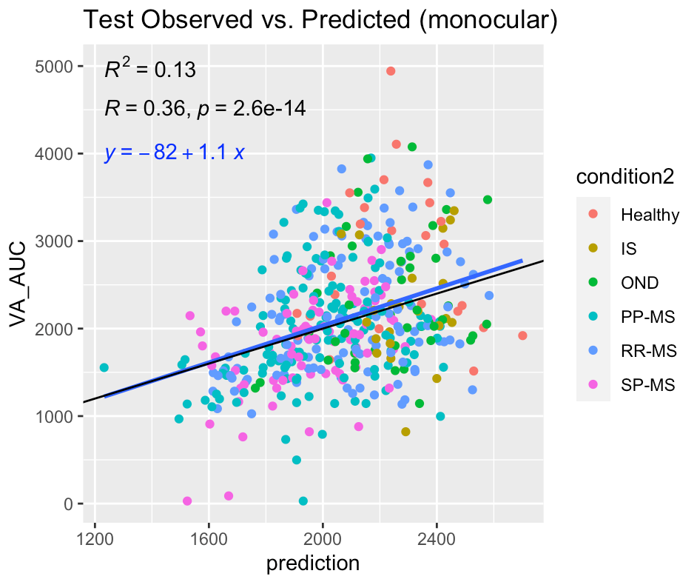
Elastic net AUC model w/ OCT (monocular)

Slide 12
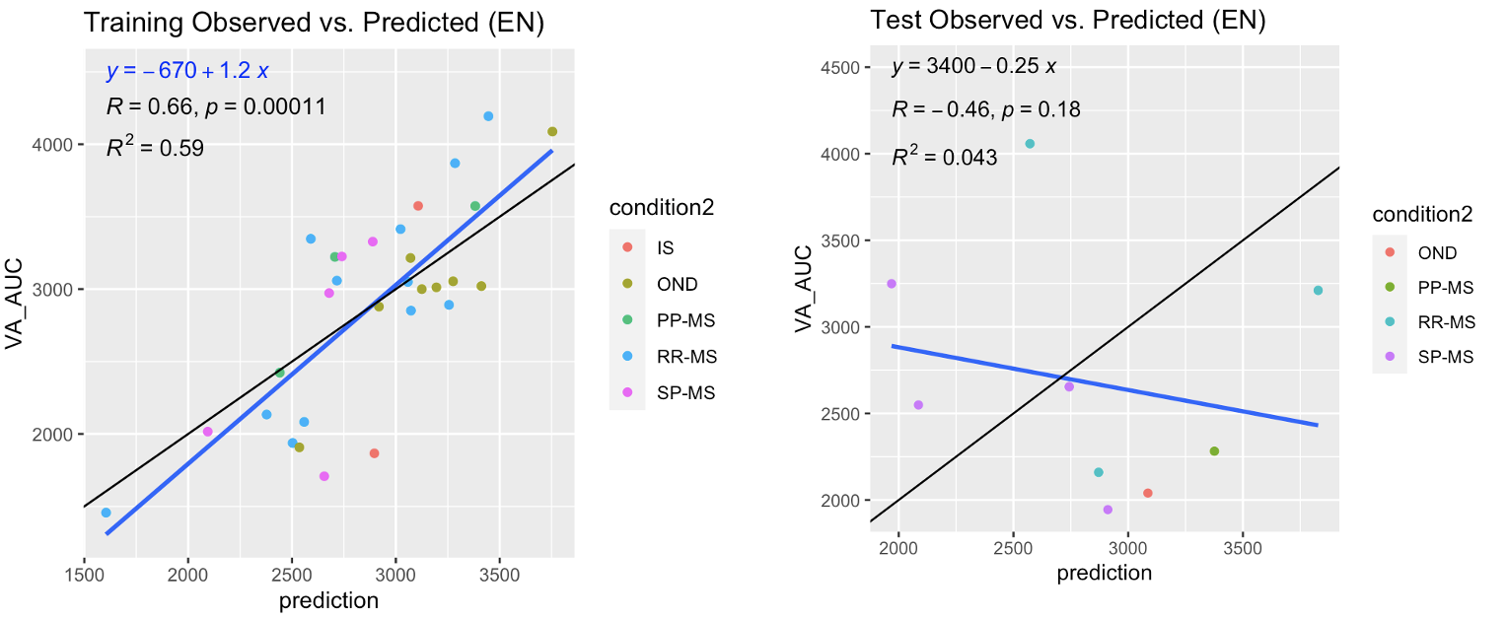
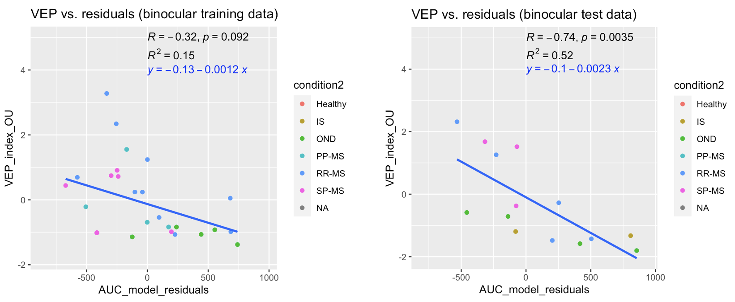
Adding VEP to binocular model
<- Adding VEP to model
Explaining residuals in OCT model ->

Slide 13
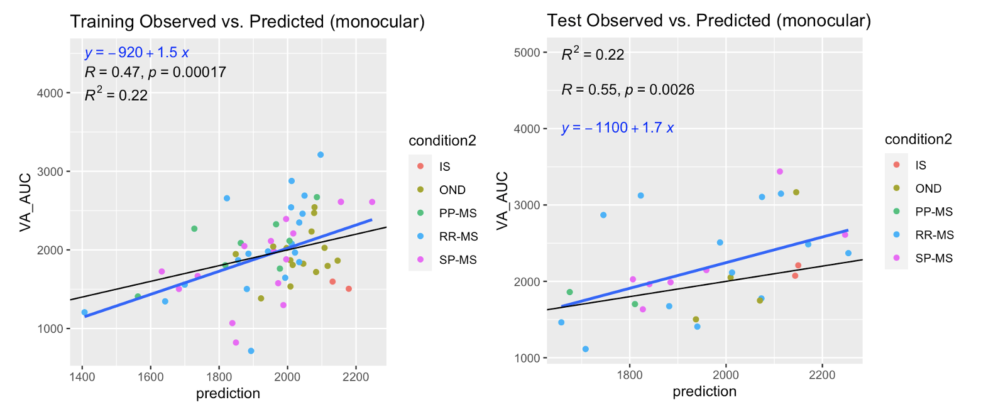
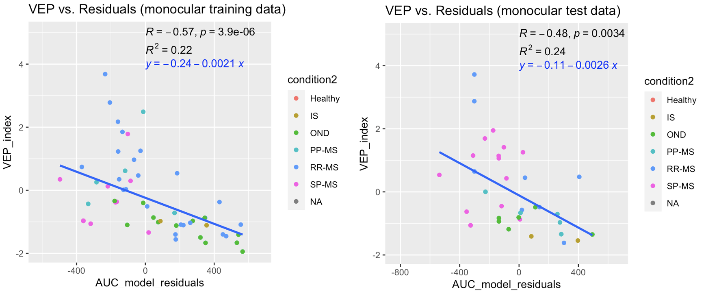
Adding VEP to monocular model
<- Adding VEP to model
Explaining residuals ->

Slide 14
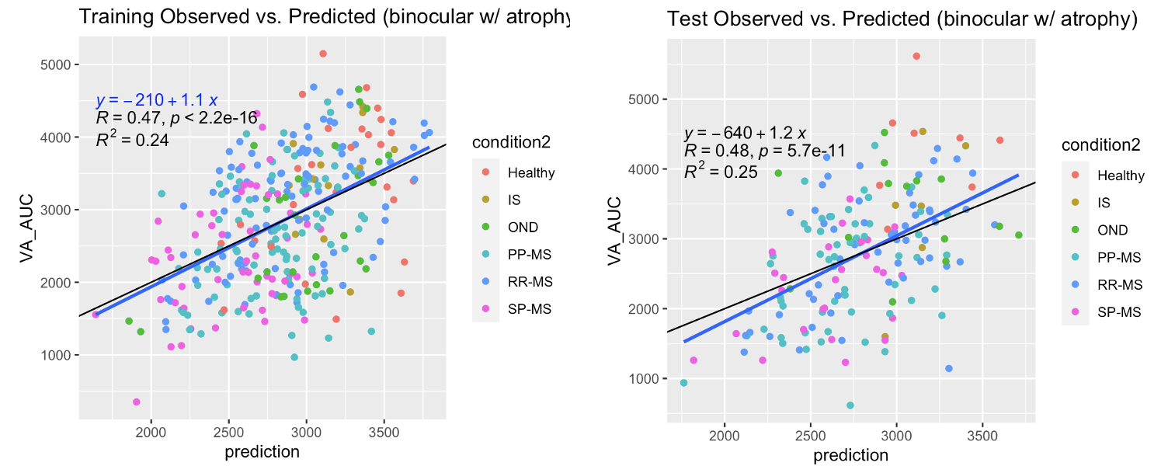
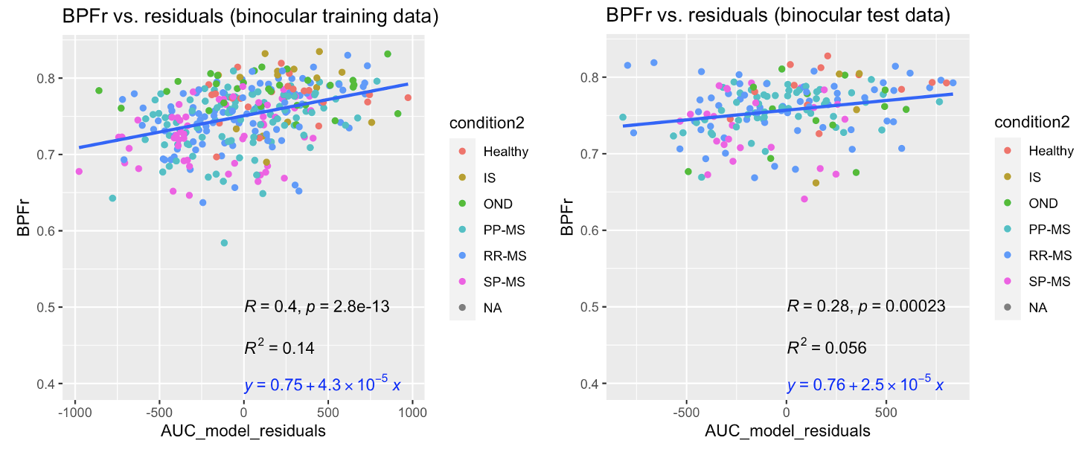
Adding atrophy to binocular model
<- Adding atrophy to model
Using BPFr to explain residuals ->

Slide 15
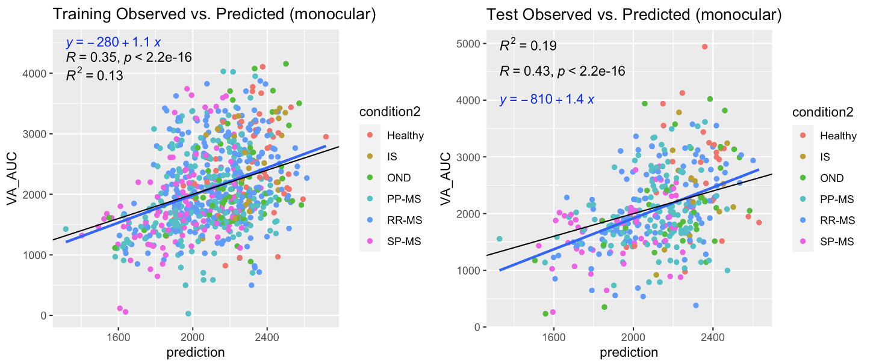
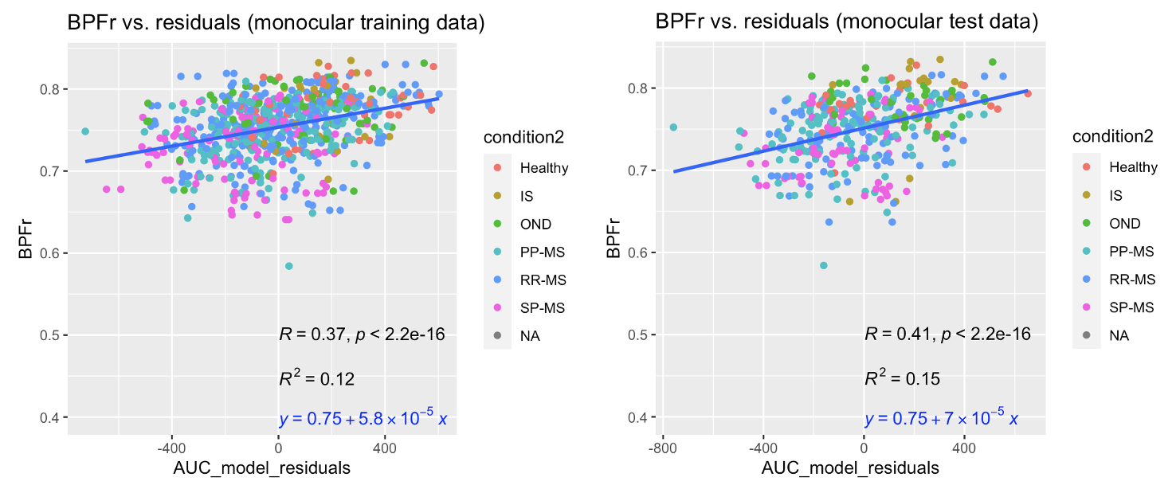
Adding atrophy to monocular model
<-Adding atrophy to model
Using BPFr to explain residuals ->

Slide 16
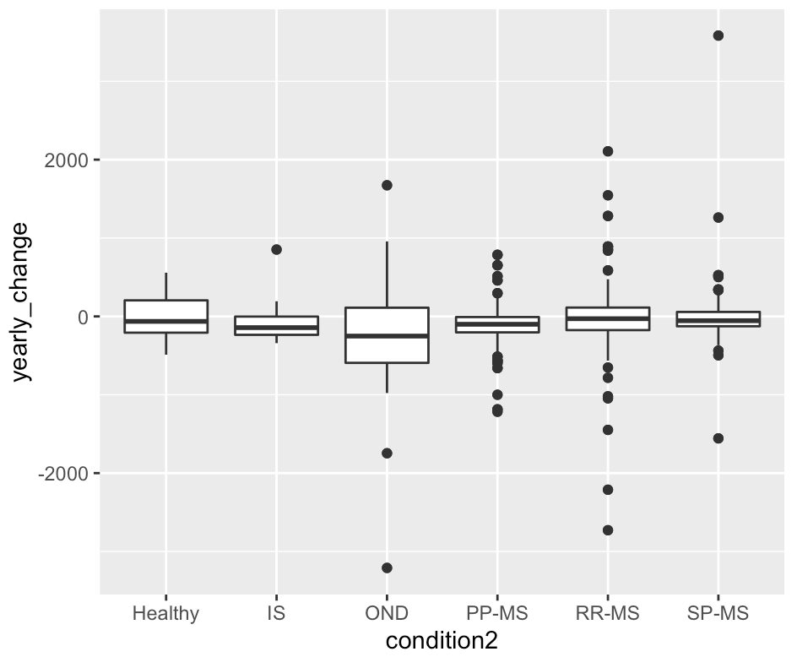
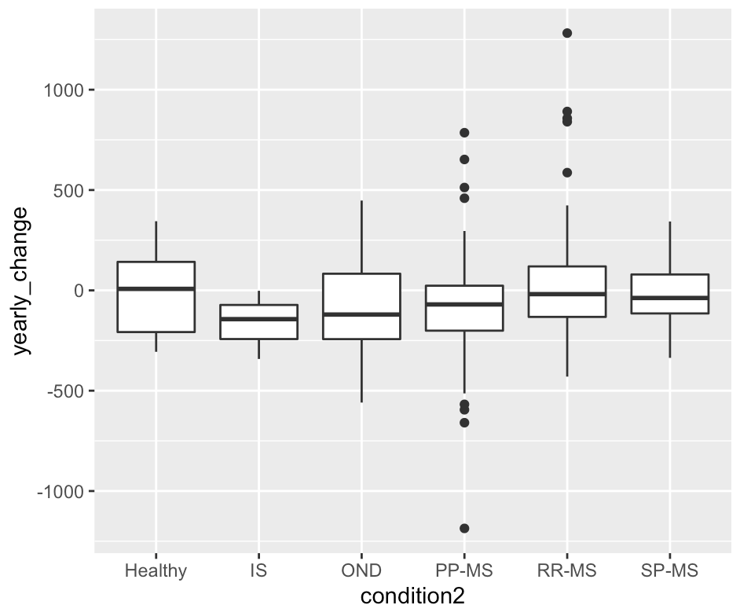
Yearly change by diagnosis
Patients with at least 2 timepoints
Patients with at least 3 timepoints

Slide 17
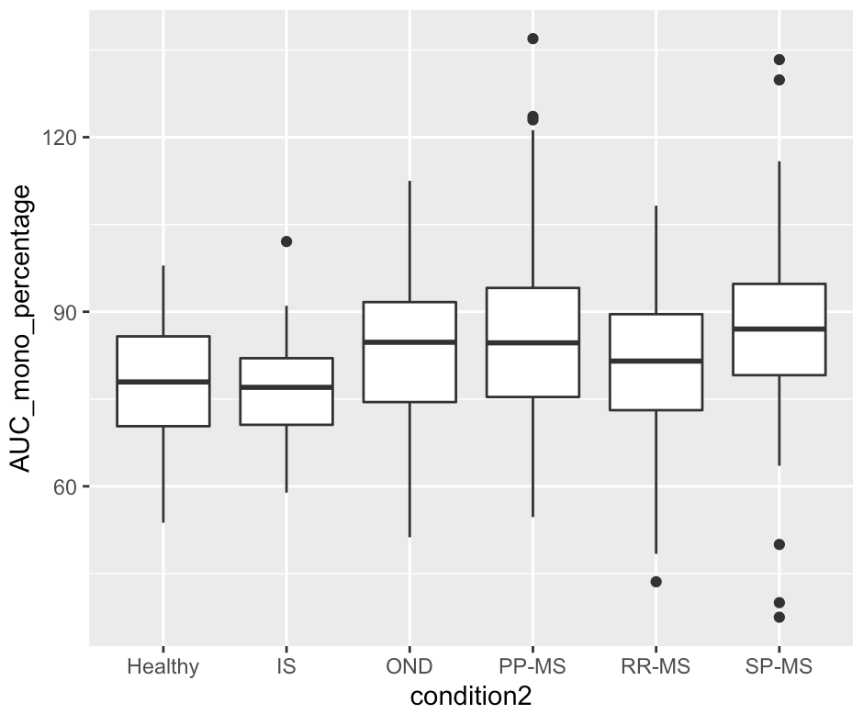
Percentage comparing better monocular eye to binocular vision
*Higher percentages mean higher
monocular/binocular ratio, 100%
means binocular and better
monocular AUC were equal

